Slide 1
Intro to Resumes
Notes:
Today I will be going over how to put together a resume that you can be proud of. Ultimately, the purpose of a resume is tell an employer that you are qualified for a job or internship. Today we will go over how to put your best foot forward in tailoring your resume for the jobs you are interested in.

Slide 2
What is a resume?
A resume is a marketing tool that showcases your education, skills, and experiences and generates interest in you.
What does a resume do?
Shows off your brand
Displays how your experiences and skills make you qualified for the job
What will make you stand out to employers?
Notes:
Your resume serves as a marketing tool to help showcase your education, skills and experiences. The goal is to tailor each resume to fit a specific job. Later I will tell you about a tool to help you in the tailoring process. It’s important to remember that submitting a general resume may not be effective in securing an interview. You want to generate interest by detailing your most relevant, and impressive skills and qualifications.

Slide 3
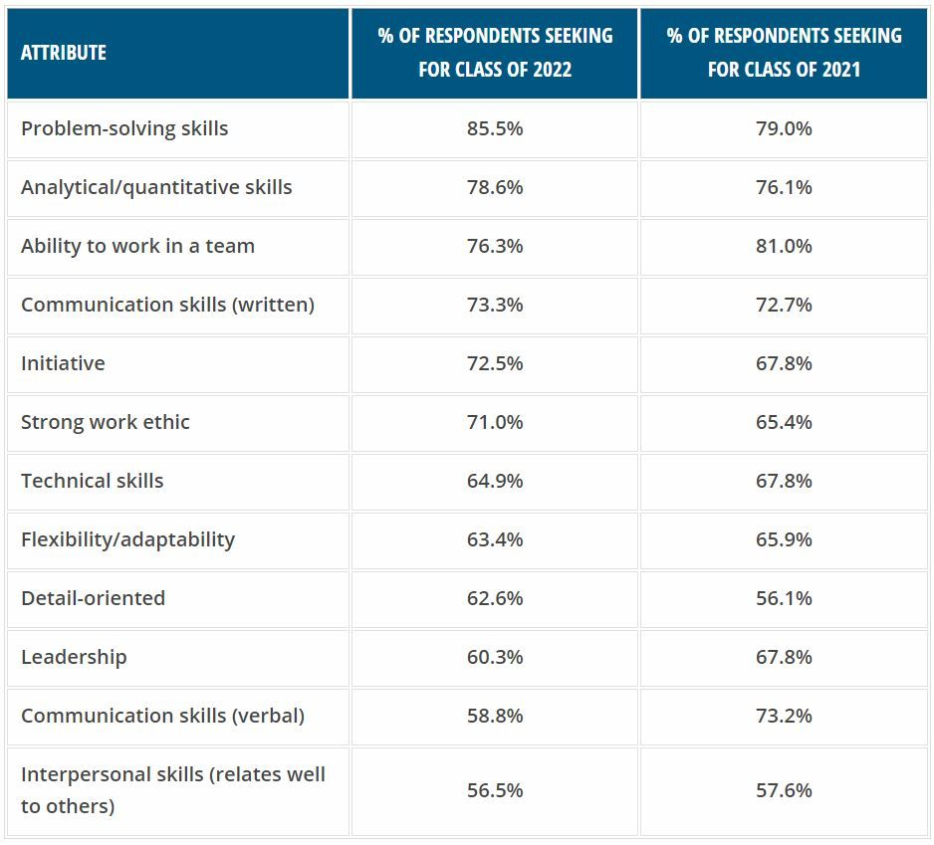
Skills Employers Value

Slide 4
A Note About Formatting
One page for most undergraduates
10-12pt size font
Times New Roman, Arial, Calibri, Helvectica
½” to 1” margins
NO color, shading, graphics, or pictures
Use bold, italics, and lines in a consistent way
Important to keep everything clean, clear, and consistent

Slide 5
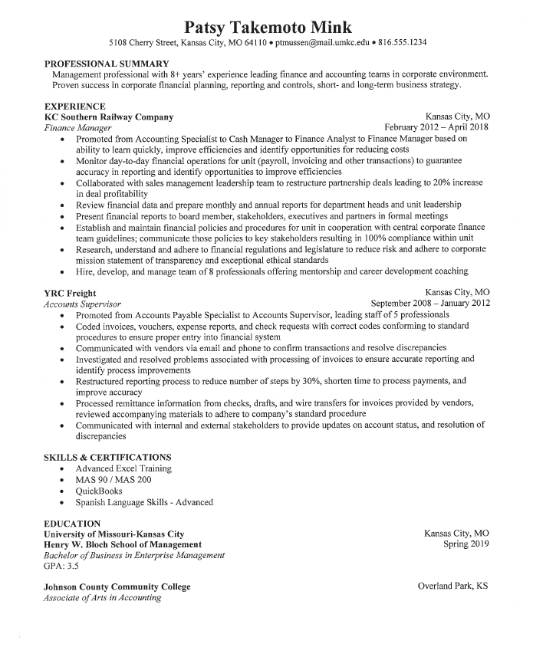
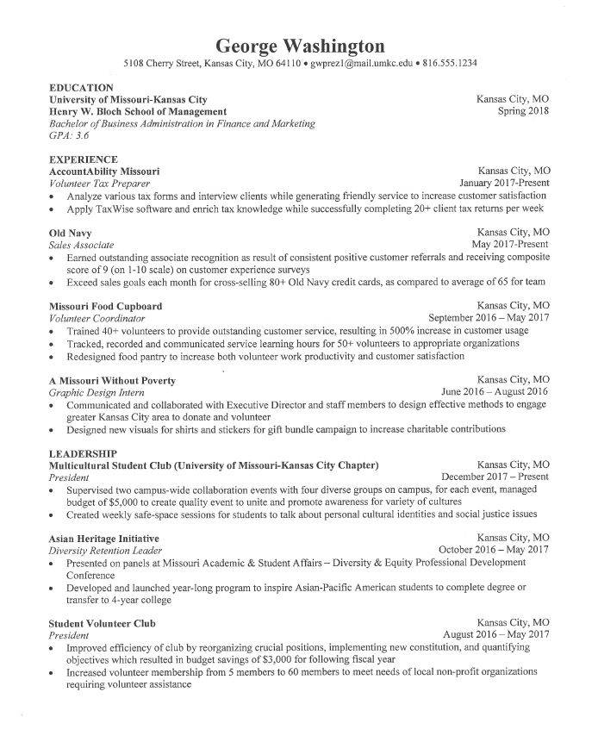

Slide 6
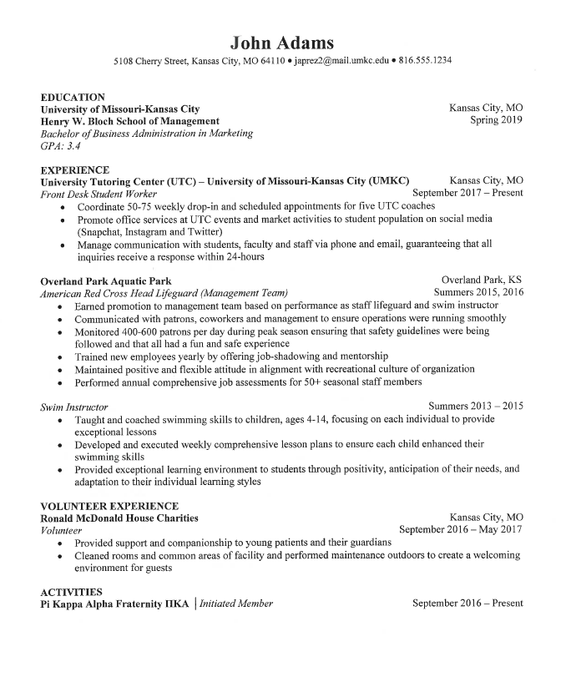
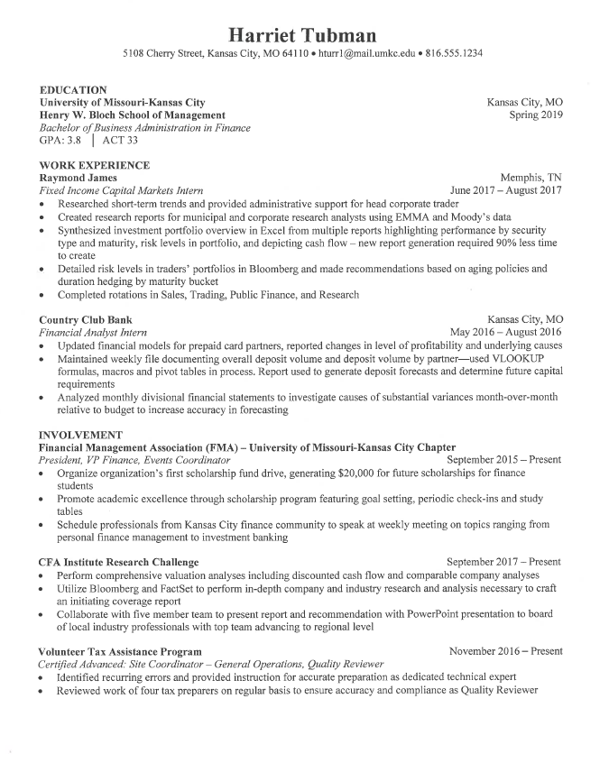

Slide 7
Preferred Order
Top of Page: Contact Information
Name, email address, phone number, LinkedIn URL, address
Next: Education
University, major, graduation date, location (city/state), GPA
Major/GPA: above a 3.0 is typically included
Optional sections:
Work/Professional Experience
Leadership Experience
Extracurricular Experience
Volunteer Experience
Awards/Accolades
Skills
Notes:
The preferred order on a resume begins with your heading and contact information. This is followed by your education. As a current student, you will want to leave education at the top of your resume until you graduate. In addition to your university and major, you will want to include your graduation date and your GPA if it is above a 3.0. You can also include your major GPA if that is higher or you want to highlight it. You can work with your academic advisor to calculate your major GPA. After education you will list some of these additional sections depending on your experience. I will now go over each section in more detail.

Slide 8
Contact Information
Kasey Roo Kasey.Roo@gmail.com | 816.555.5678 | linkedin.com/kaseyroo
In your heading include:
Professional email address
Cell phone number (which includes a professional voicemail message)
LinkedIn URL
Mailing address is optional
Notes:
Your heading should start with your name, big and bold at the top of your resume. This will be followed by your email address, phone number, and LinkedIn URL. To ensure that your LinkedIn URL doesn’t include random numbers and letters at the end, Google “Personalize LinkedIn URL” and follow the directions. Including your physical address is optional, but in general you don’t need it. If you are relocating and would like to include your new address, that could help employers know that you are serious about moving to their city.

Slide 9
Education - Undergrad
Education
University of Missouri – Kansas City
Bachelor of Science in Accounting
May 2021 (include CPA eligible date if pursuing public accounting)
GPA: 3.5/4.0
Education
University of Missouri – Kansas City
Bachelor of Business Administration
Emphasis: Finance
Minor: Information Technology
May 2021
GPA: 3.5/4.0
Education
University of Missouri – Kansas City
Bachelor of Business Administration
Emphasis: Marketing
May 2021
GPA: 3.5/4.0
Notes:
As a Bloch student, you are either pursuing a Bachelor of Science in Accounting or a Bachelor of Business Administration with an emphasis area. This slide shows you how to layout either degree. If you are accounting and plan to pursue the CPA, make sure you include your CPA eligible date as well as your graduation date. You will notice each example includes UMKC, your degree, graduation date, and GPA.

Slide 10
Education - Graduate
Education
University of Missouri – Kansas City
Master of Business Administration (MBA)
May 2022
GPA: 3.5/4.0
Education
University of Missouri – Kansas City
Master of Science in Accounting
CPA Eligible/Graduation: May 2021
GPA: 3.5/4.0
Bachelor of Science in Accounting
May 2020
Education
University of Missouri – Kansas City
Master of Public Administration
May 2021
GPA: 3.5/4.0
Notes:
Listing your graduate degree is very similar to your undergraduate degree, it just sits above your undergrad degree. Everything on a resume moves in reverse chronological order, from most recent to least recent.

Slide 11
Education - Exceptions
Education
University of Missouri – Kansas City
Bachelor of Science in Accounting
May 2021
GPA: 3.5/4.0
Johnson County Community College
Associate of Arts
University of Florence, Florence, Italy
Study Abroad
Summer 2019
Notes:
A few additional items you may include under your education section include other universities you’ve attended, including community colleges, as well as study abroad and language fluencies. If you speak multiple languages, make sure you list the level of fluency you have in each language as you see here.

Slide 12
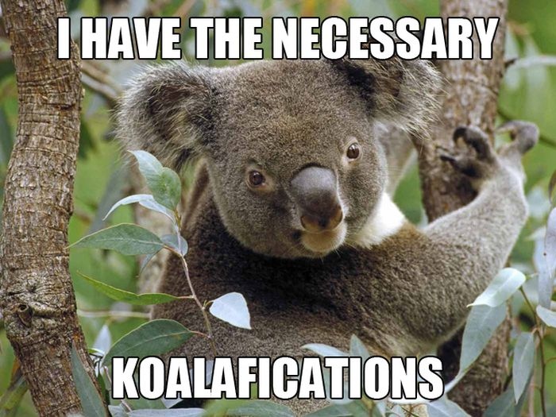
Experience
Be sure to include:
Proper names, job titles
Dates and locations (city/state)
Your contribution to the organization
Bullet all of your job duties
Quantify on your resume whenever possible
Expand on your Role, your Contribution, and your Impact
Do not use complete sentences, periods, or personal pronouns like,“I”,“me”, or “we”
List your relevant experiences in reverse chronological order, beginning with your most recent position and proceeding backwards
Think about Accomplished [X] as measured by [Y] by doing [Z] or Skill + Task + Result when writing your bullet points
Notes:
A resume is not a laundry list of every experience you’ve ever had. It should be a tailored, detailed snapshot of your experiences that are most related to what you’re applying for. Each of your sections, especially under work experience, should contain proper company names and job titles. You will need to include the dates you worked, both month and year. Each one of your bullet points should be a detailed account of one of your job duties, highlighting your role, contribution and impact. You should always quantify on your resume whenever possible. “Trained employees” doesn’t sound that impressive but “Trained 25 employees in all company policies and procedures, ensuring proper attention was given to customer service, retention, and communication” paints a much clearer picture.

Slide 13
Internship Experience
Forward Sports Marketing Lee’s Summit, MO
Customer Support Intern September 2019 – Present
Establish consultative relationships with clients and partners to demonstrate value of company’s marketing services.
Communicate with clients to design and customize innovative solutions to meet their marketing needs.
Negotiate entire sales relationships from prospecting, cold calling, qualifying, and closing deals.
Attend NHRA Racing events to build rapport with clients and prospective sponsors.
Notes:
For each of the next few slides, you will see how best to set up your experiences under each heading. You may decide to include an “Internship Experience” section on your resume. You will notice that this experience includes the name of the company, the internship title, the location, the dates, and detailed bullet points about the role. You can play to have anywhere between 2 and 5 bullet points per experience.

Slide 14
Work Experience
Kansas City Chiefs Kansas City, MO Stadium Tour Guide May – December 2018
Served as face of Kansas City Chiefs and Arrowhead Stadium for fans and tourists on stadium tours.
Performed over 100 tours for groups up to 30 fans each.
Designed and customized each tour to group to create excellent, memorable fan experience through energetic and knowledgeable tour and presentation of Kansas City Chiefs and Arrowhead Stadium.
Researched history and competitive edge of stadium and organization in order to become subject matter expert on topics potentially brought up during tours.
Collaborated and communicated with team of tour guides to learn best practices and receive feedback to be used in adapting and improving techniques.
Notes:
Most commonly you will see a “Work or Professional Experience” section on a resume. The experience is formatted exactly like the internship. You will notice this experience has also included a quantifiable data point, letting the employer know that this person lead tours for hundreds of people.

Slide 15
Work Experience
Old Navy Kansas City, MO
Sales Associate May 2019 - Present
Earned outstanding associate recognition as result of consistent positive customer referrals and receiving composite score of 9 (on 1-10 scale) on customer experience surveys
Exceed sales goals each month for cross-selling 80+ Old Navy credit cards, as compared to average of 65 for team
Notes:
Most commonly you will see a “Work or Professional Experience” section on a resume. The experience is formatted exactly like the internship. You will notice this experience has also included a quantifiable data point, letting the employer know that this person lead tours for hundreds of people.

Slide 16
Work Experience
University Tutoring Center (UTC) – University of Missouri-Kansas City (UMKC) Kansas City, MO
Front Desk Student Worker September 2021 – Present
Coordinate 50-75 weekly drop-in and scheduled appointments for five UTC coaches
Promote office services at UTC events and market activities to student population on social media (Snapchat, Instagram and Twitter)
Manage communication with students, faculty and staff via phone and email, guaranteeing that all inquiries receive a response within 24-hours
Notes:
Most commonly you will see a “Work or Professional Experience” section on a resume. The experience is formatted exactly like the internship. You will notice this experience has also included a quantifiable data point, letting the employer know that this person lead tours for hundreds of people.

Slide 17
Leadership Experience
Alpha Kappa Psi, University of Missouri – Kansas City December 2019 – Present
President
Manage board of directors and officers to achieve goals and objectives.
Serve as Director at Large to help run meetings, activities, games, and banquets for chapter members
Multicultural Student Club, University of Missouri-Kansas City December 2020 – Present
President
Supervised two campus-wide collaboration events with four diverse groups on campus, for each event, managed budget of $5,000 to create quality event to unite and promote awareness for variety of cultures
Created weekly safe-space sessions for students to talk about personal cultural identities and social justice issues
Enactus, University of Missouri – Kansas City Spring 2019 -Present
Member
Notes:
As a busy college student, you may also have on-campus leadership experience that will be laid out like this slide. You may or may not want to get into as much detail here as you did in your work experience section, but you certainly can depending on space. Most importantly you will want to list the name of the organization, your role, dates, and any pertinent accomplishments.

Slide 18
Volunteer Experience
Therapeutic Riding Pittsburg, MO
Organizer May 2019 – Present
Prepare, organize, and create projects for children with physical and mental disabilities to ride and learn horsemanship.
A Plus Student Tutoring Program Lee’s Summit, MO
Student Tutor 50 Hours
Educated students in English and math, assessed education needs, customized training, adapted to learning styles.
Served as role model through open and collaborative communication and professional behavior.
Notes:
If you are heavily involved in the community, you may decide to include a volunteer section. Much like leadership experience, you can go into as little or as much detail as you’d like. One thing to note here is that it may be more impactful to list the amount of hours you volunteered vs the dates.

Slide 19
Awards & Accolades
Dean’s List, UMKC Bloch School of Management Fall 2020
Staff Member of the Month, Cerner April 2019
Chancellor’s Scholarship, UMKC Fall 2018
Note: Awards and accolades should always be in chronological order – don’t include every scholarship you’ve earned, just the most relevant/impressive
Notes:
Awards & Accolades is another section you may consider including on your resume. I would encourage you to stick to the 3-4 most impressive achievements, instead of doing a long list of every scholarship you’ve earned.

Slide 20
Skills & Certifications
Skills: Microsoft Office Suite including Excel PeopleSoft HTML and Java Bloomberg CSS, SQL, PHP
Fluent in Spanish; Intermediate French
Certifications: SHRM-CP (August 2020) CPA (May 2020) AdWords (September 2019)
Note: Skills should be limited to languages, technology or software. Utilize soft skills like communication, organization, and time management in your work bullet points. Show me, don’t tell me.
Notes:
On most job descriptions you will find desired skills. If you have a lot of technology or software skills, this is a great section to include to list them. As noted on the slide, this is not a section to include soft skills like communication, organization or time management. Those skills are better utilized in your work bullets. For those skills, don't just tell me you have great communication skills, show me how you use them in one of your bullet points under a job or internship.

Slide 21
Business Projects
Relevant Class Projects
Business Communications, Spring 2020
Created professional portfolio that included writing samples, feedback on interview skills, and professional application materials
International Management, Fall 2019
Studied Brazil’s economy to determine strengths and weaknesses in workforce development, budget, and infrastructure
Presented findings to panel of Kansas City-area business professionals
Notes:
Finally, you may find it helpful to include a section that describes some of the projects you have done in class, especially if they are relevant to your career goals. Include a bullet or two with the most pertinent details of the project, as well as the full name of the class. An example includes listing “Business Communications” instead of “Management 301”.

Slide 22
Check Your Work
Bloch Career Center
102 Bloch Executive Hall
bloch.umkc.edu/career-center/
Handshake
To schedule an appointment to have your resume reviewed
https://umkc.joinhandshake.com/
Jobscan
Register with your UMKC email to access premium features
https://www.jobscan.co/
UMKC Writing Studio
Hours and locations vary, check their website for schedule
https://www.umkc.edu/writingstudio/
Notes:
After you have completed your resume, it is important to have it reviewed. The Bloch Career Center should be your first stop. Sitting down with an experienced career coach or consultant will ensure that your resume is on the right track. The UMKC Writing Studio can also give you feedback on your grammar, punctuation, and syntax. Once you’ve been given the thumbs up by the career center, scan your resume into Jobscan to see how it stacks up to the job descriptions you’ve identified. Jobscan will tell you how well tailored your resume is the jobs you’re applying for and will give you tips on how to make it stronger. Finally, when you’re ready to apply, head over to Handshake to submit your applications!

Slide 23
Parting Advice
It’s a work in progress (meaning it’s never done and always evolving)
Be open to feedback, and don’t take it personally
Get it reviewed, often, and most importantly the Bloch Career Center)
Be proud of all your hard work!
Notes:
Your resume is a living document that will be constantly tweaked for the rest of your career. As you make edits, changes, and add content, be open to feedback, but don’t take it personally if someone thinks you should change something. There are a lot of opinions out there, and it’s important to get a well-rounded view. The Bloch Career Center bases its coaching on recruiter feedback, and you can trust us to be up to date on all the latest resume trends. It’s a lot of work to put together a strong resume so be proud of yourself and your accomplishment. You’re just a few steps away from landing that next big job!

